Slide 1
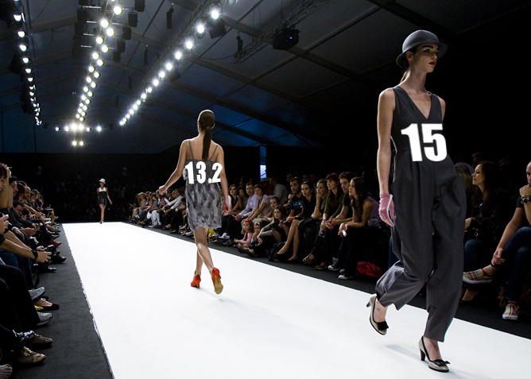
V15 dans toute sa plendeur
Paris 2016
Toutes les nouveautes de V15
Dan Baronet
Dyalog
Notes:
Ce printemps Dyalog annonce les nouveautes 2016. Salutations. Presentations.

Slide 2
Agenda
Dyalog 15.0
RIDE 3.0
Conga 3.0
MiServer 3.0
Notes:
Find how many people use Dyalog, which version?

Slide 3
Dyalog 15.0 Highlights
Very Significant Speed-Ups
Windows Installation without Administrative Privileges
New Cross-Platform Native File Functions
Support for Source Files in the interpreter
Data “outside the workspace”
Fast lookups
Compiler Enhancements
Notes:
NO new language features

Slide 4
Environment modifications
Editor
  Italics/bold in comments?
  Source can be kept outside the ws
  Available as external editor in Windows
Native Look & feel enabled by default
Ignore traps in the session

Slide 5
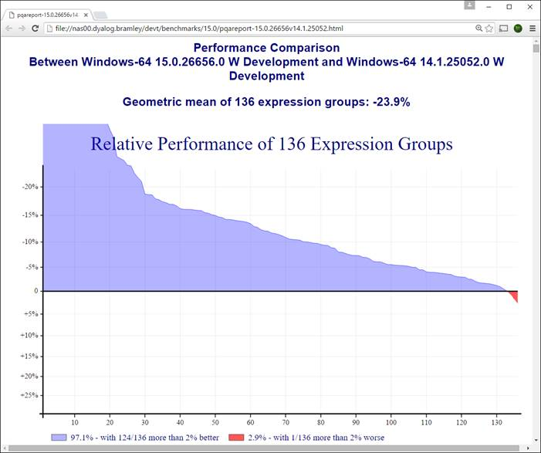
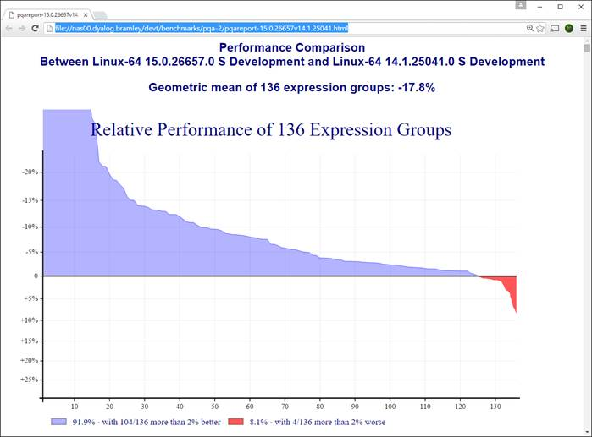
Version 15.0 Performance
Possibly the largest speedup in history
New algorithms
New C compilers on all platforms
  Windows: VS2005 => VS2015
  Linux: gcc 4.3.3 (2009) => 5.3 (2015)
  AIX xlc has been “current”

Slide 6
Version 15.0: Restrictions
Windows XP not supported (Minimum versions are Vista or Server 2008)
Microsoft.NET version 4 or higher required
New RIDE 3.0 for Dyalog 15.0 only
No more )LOAD <V11 wss
No more 13.2 support
Since 14.0 32b files can no longer be created.

Slide 7
Language specific changes

Slide 8
Random Link (⎕RL)
[1] is seed
[2] is RN generator:
  0: range [1,(2*31)-2] (the "old" RNG)
  1: range [1,2*62[
  2: OS generated values [1,2*62[
Ex:
⎕RL←1234 0

Slide 9
New neutral element
,/⍬ is ⊂⍬

Slide 10
7 new ⎕ OS functions
⎕NPARTS
⎕NEXISTS
⎕MKDIR
⎕NDELETE
⎕NINFO
⎕NGET
⎕NPUT

Slide 11
7 new ⎕ OS functions
⎕NPARTS
  Path
  Base name
  Extension
If a left argument of 1 is supplied the path is resolved (''=CD, ..=up, etc.)
The result R is a 3-element vector of character vectors as follows:

Slide 12
⎕NPARTS
⎕NPARTS '\path\file.ext'
\path\ file .ext

Slide 13
⎕NEXISTS
⎕NEXISTS '\path\file.ext'
1 ou 0

Slide 14
⎕MKDIR
⎕NEXISTS '\Documents\temp'
0
⎕←0 ⎕MKDIR '\Documents\temp'
1
0 | The path specified by Y must exist and the base name specified by Y must not exist Otherwise an error is signalled.
1 | No action is taken if the directory specified by Y already exists. The return value may be used to determine whether a new directory was created or not.
2 | Any part of the path specified in Y which does not already exist will be created in preparation of creating Y itself.
3 | Combination of 1 and 2.

Slide 15
⎕NDELETE
⎕NEXISTS '\Documents\temp\t1\t2'
1
⎕←⎕NDELETE'\Documents\temp\t1\t2'
1
⎕←⎕NDELETE'\Documents\temp\t1\t2'
FILE NAME ERROR
⎕←1 ⎕NDELETE'\Documents\temp\t1\t2'
0

Slide 16
⎕NINFO
Left argument 0-7
  Name
  Type
  Size
  Timestamp
  Owner id
  Owner name
  Permission to write
  Hidden

Slide 17
⎕NGet/NPut/Fix
⎕NGET File [flags]
Returns (contents transformation NL)
( contents transformation NL) ⎕NPUT file [flags]
Returns the size of the file created.
⎕FIX accepts a filename as argument as well as source as before

Slide 18
Special

Slide 19
Hashed keys
Used with iota (Find) and epsilon (MemberOf)

Slide 20
New idiom
XA↓⍨←NS (for NS<0)

Slide 21
Case folding
(819⌶) 'How many Roads must a man walk down'
HOW MANY ROADS MUST A MAN WALK DOWN
1(819⌶)'Général Haïtien'
GÉNÉRAL HAÏTIEN

Slide 22
Ws
User data outside of the workspace
Not subject to ⎕WA
Not involved in normal compaction/garbage collections
Specified by user with large semi-static metadata (prices etc)

Slide 23
.Net

Slide 24
Remove Data Binding
2014⌶'txtSource'
1
Null value returned from .NET method becomes ⎕NULL

Slide 25
Discard Thread on Exit
APL threads that Dyalog creates to serve incoming .NET requests are not terminated when their work is done. They persist so that if another call comes in on the same .NET thread the same APL thread can handle it. In effect the thread is parked until it is needed again. If the thread is not required, there is a small performance cost in maintaining it in this state.
(2501⌶0) is called from WITHIN one of these threads and tells the interpreter NOT to park the thread on termination, but to discard the thread completely.

Slide 26
Discard Parked Threads
when called from a thread 2502 IB removes all parked threads from the workspace.

Slide 27
DISPID (Dispatch ID)
COM objects created by Dyalog (OLEServer and ActiveXControl objects) export their members (methods, properties and events) using the standard IDispatch interface.
Using this interface, a client application may discover the names and parameters of the members supported by an object at run-time, and then access them by name. Alternatively, a client application may compile references to the object's members in advance using their Dispatch IDs or DISPIDs.

Slide 28
Interoperability
⍤, ⍠ and ⌸
Are represented by
⎕U2364, ⎕U2360 and ⎕U2338 respectively
In Classic (this was in 14.1 already)

Slide 29
Demos

Slide 30
RIDE 3.0 – Expected Features
New Protocol (JSON)
Launch server-side processes using SSH
Minimal workspace explorer
Support external editors
Value tips
Enhanced navigation of classes and functions ("Back")
Show stack, Show threads, Status bar
Drag/drop workspaces or source files to session
Auto PW support

Slide 31
Planned Conga 3.0 (TCP) Features
New Server Modes: Single Queue & Connection-Per-Thread
New version GNU TLS, loaded on demand
HTTP Protocol & Web Socket support
EndPoint filter to control connections
Send File Command & Send Complete event
Close event instead of error 1119
Stop/pause server listening for new connections
Accept numeric data for text connections

Slide 32
Planned Conga 3.0 (TCP) Features
HTTP Protocol & Web Socket support
EndPoint filter to control connections
Send File Command & Send Complete event
Close event instead of error 1119
Stop/pause server listening for new connections
Accept numeric data for text connections

Slide 33
Possible Conga 3.0 Features
UDP
Multiple application roots
Compression of data for command connections

Slide 34
MiServer
Version 3.0 in May
Commercial Applications Being Developed Now
Embedded HTTP Rendering coming this summer
Version 4.0 will bring Data Binding

Slide 35
Version 16.0 Ideas
Dual / Under

Slide 36
Other

Slide 37
Contest 2016
Winner declared in glasgow

